Slide 1
PRESENTATION ON PHP AJAX LIVE SEARCHING.
TASK #1 FOR INTERNSHIP.
Presentation on php ajax live search.

Slide 2
CONTAINS FOUR FILES.
3 php, 1 js.
3 php files has one config.php file which creates a connection with mysql database.
Another php file contains the front end for the implementation of the topic.
And the last file is named as ajax.php which finds the required in the database in accordance with ajax script.
Js file includes jquery as well as ajax.

Slide 3
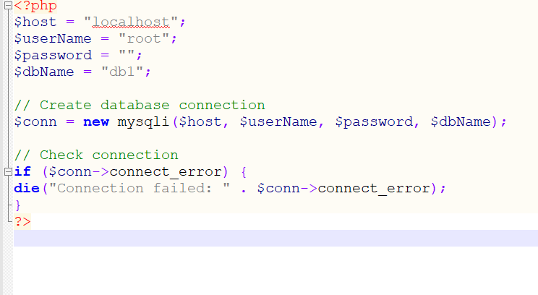
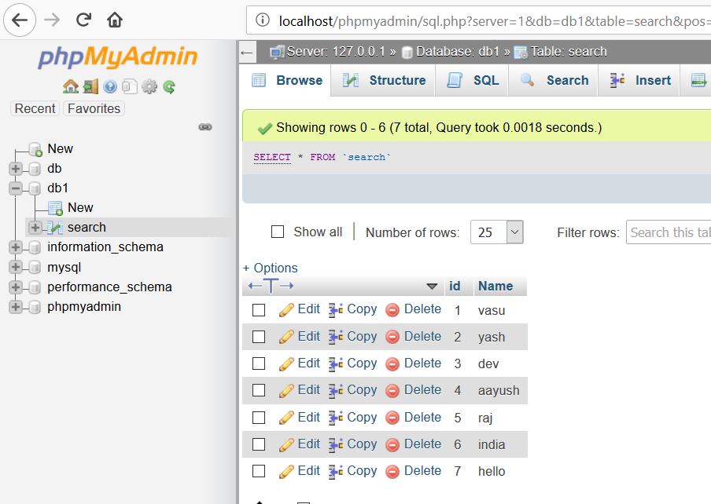
Config.php
The above code snippet creates a connection with database “db1”.

Slide 4
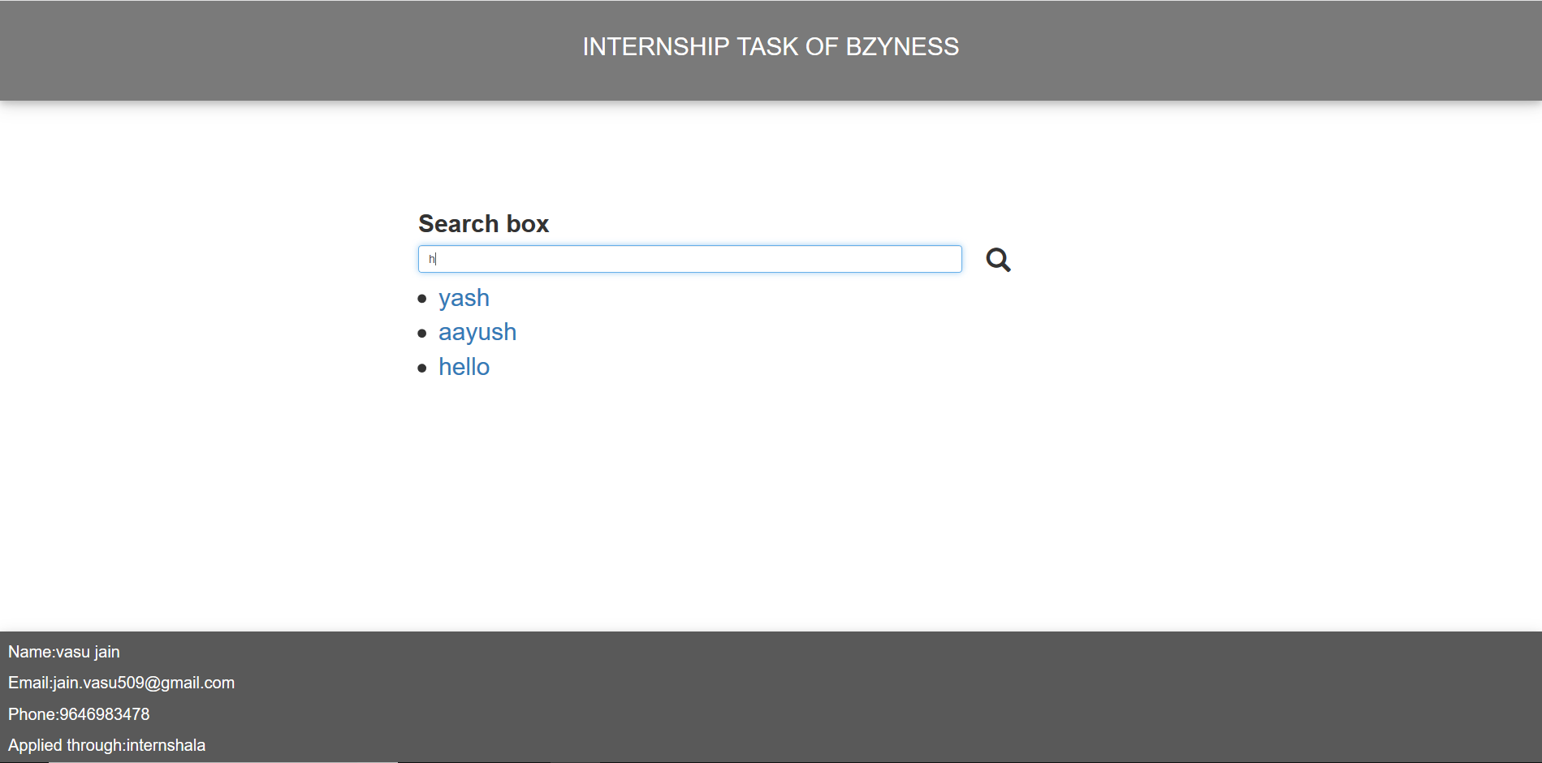
Search.php
This file includes bootstrap and css for styling of the page.
Bootstrap file and script.js file is included in the head tag.
Code snippet cannot be attached because of large lines of code please refer to implementation part.
One search bar is created in which we search through the names in database

